Slide 1
新特性之MAPI over HTTP
产品 | Exchange 2013 SP1 | Exchange 2013 RTM | Exchange 2010 SP3 | Exchange 2007 SP3
Outlook 2013 SP1 | MAPI over HTTP Outlook 无处不在 | Outlook 无处不在 | RPC Outlook 无处不在 | RPC Outlook 无处不在
Outlook 2013 RTM | Outlook 无处不在 | Outlook 无处不在 | RPC Outlook 无处不在 | RPC Outlook 无处不在
Outlook 2010 SP2 和更新 KB2956191 以及 KB2965295（2015 年 4 月 14 日） | MAPI over HTTP Outlook 无处不在 | Outlook 无处不在 | RPC Outlook 无处不在 | RPC Outlook 无处不在
Outlook 2010 SP2 和更低版本 | Outlook 无处不在 | Outlook 无处不在 | RPC Outlook 无处不在 | RPC Outlook 无处不在
Outlook 2007 | Outlook 无处不在 | Outlook 无处不在 | RPC Outlook 无处不在 | RPC Outlook 无处不在

Slide 2
新特性之MAPI over HTTP
Product | Exchange 2016 RTM | Exchange 2013 SP1 | Exchange 2013 RTM | Exchange 2010 SP3
Outlook 2016 RTM | MAPI over HTTP Outlook Anywhere | MAPI over HTTP Outlook Anywhere | Outlook Anywhere | RPC Outlook Anywhere
Outlook 2013 SP1 | MAPI over HTTP Outlook Anywhere | MAPI over HTTP Outlook Anywhere | Outlook Anywhere | RPC Outlook Anywhere
Outlook 2013 RTM | Outlook Anywhere | Outlook Anywhere | Outlook Anywhere | RPC Outlook Anywhere
Outlook 2010 SP2 and updates KB2956191 and KB2965295 (April 14, 2015) | MAPI over HTTP Outlook Anywhere | MAPI over HTTP Outlook Anywhere | Outlook Anywhere | RPC Outlook Anywhere
Outlook 2010 SP2 and earlier | Outlook Anywhere | Outlook Anywhere | Outlook Anywhere | RPC Outlook Anywhere
Outlook 2007 | Outlook Anywhere | Outlook Anywhere | Outlook Anywhere | RPC Outlook Anywhere
MAPI over HTTP in Exchange 2016 https://technet.microsoft.com/zh-cn/library/dn635177(v%3Dexchg.160).aspx
Configure MAPI over HTTP https://technet.microsoft.com/zh-cn/library/mt634322(v=exchg.160).aspx

Slide 3
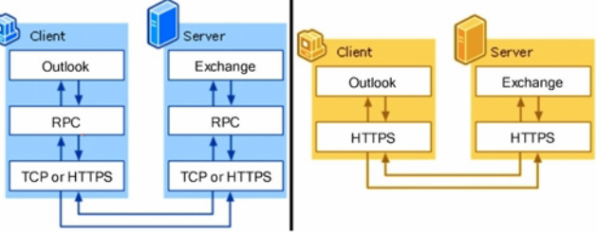
新特性之MAPI over HTTP
去RPC化
连接速度更快，MAPI直接封装在HTTP里面
RPC OVER HTTP的封装是：MAPI/RPC/HTTP

